Slide 1
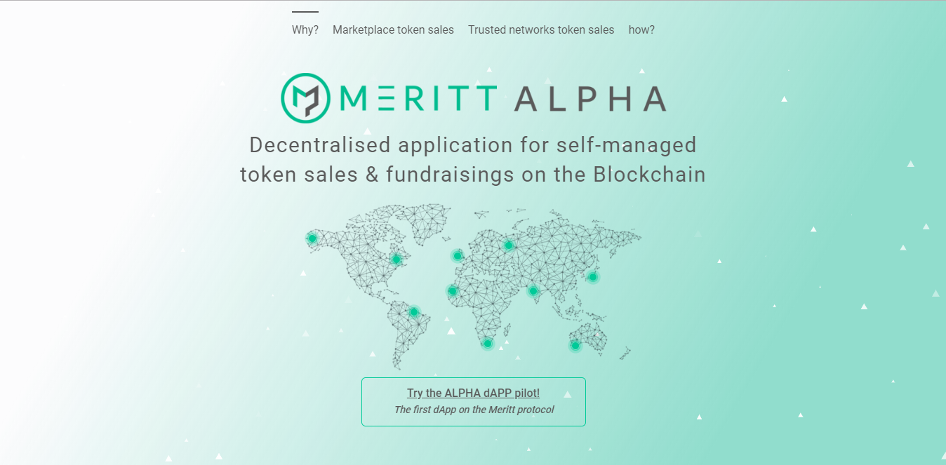
Smaller logo
(see next page)
Please Put gradient in this corner, corner has to display full base colour
(see next page)
Please decrease font -2 for "Decentralised application for self-managed token sales & fundraisings on the Blockchain"

Slide 2

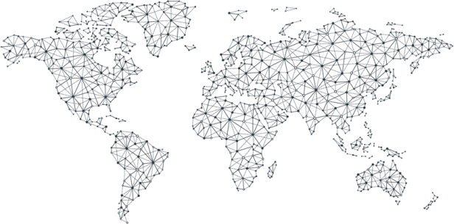
My slide
Why? | Marketplace token sales | Trusted networks token sales | How?
M RITT ALPHA
Decentralised application for self-managed token sales & fundraisings on the Blockchain
Try the ALPHA dAPP pilot!
The first dApp on the Meritt protocol

Slide 3
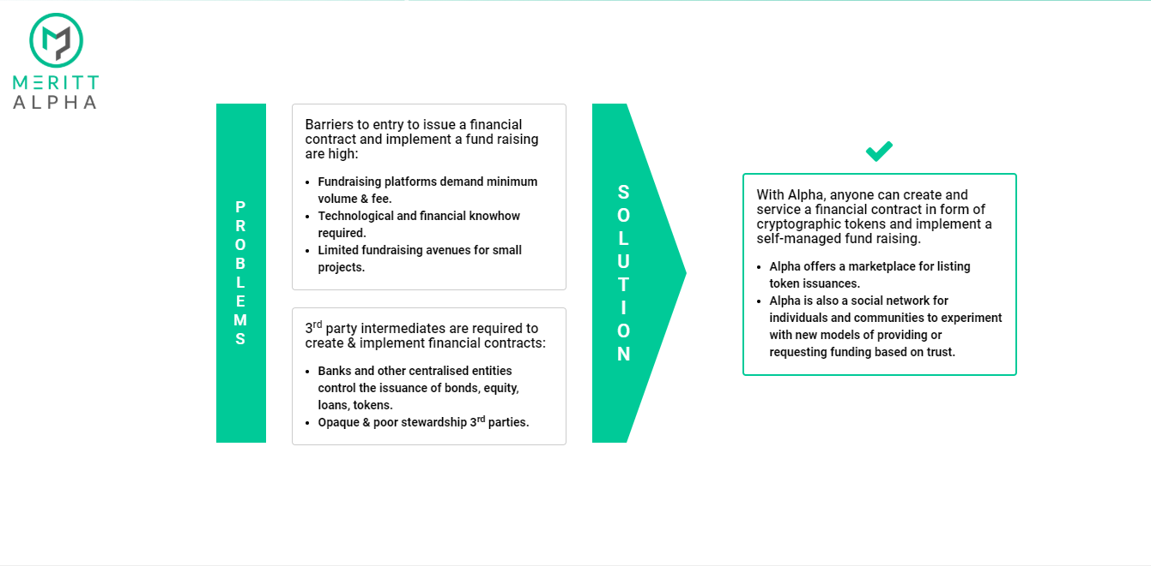
Please make sure all red arrow space are the exact same distance / space
-Please refer to next page for text formatting
-Title in bold
-text below is not bold

Slide 4
My slide
PROBLEMS
Barriers to entry to issue a financial contract and implement a fund raising are high:
Fundraising platforms demand minimum volume & fee.
Technological and financial knowhow required.
Limited fundraising avenues for small projects.\
SOLUTION
With Alpha, anyone can create and service a financial contract in form of cryptographic tokens and implement a self-managed fund raising.
Alpha offers a marketplace for listing token issuances.
Alpha is also a social network for individuals and communities to experiment with new models of providing or requesting funding based on trust.
3rd party intermediates are required to create & implement financial contracts:
Banks and other centralised entities control the issuance of bonds, equity, loans, tokens.
Opaque & poor stewardship 3rd parties.

Slide 5
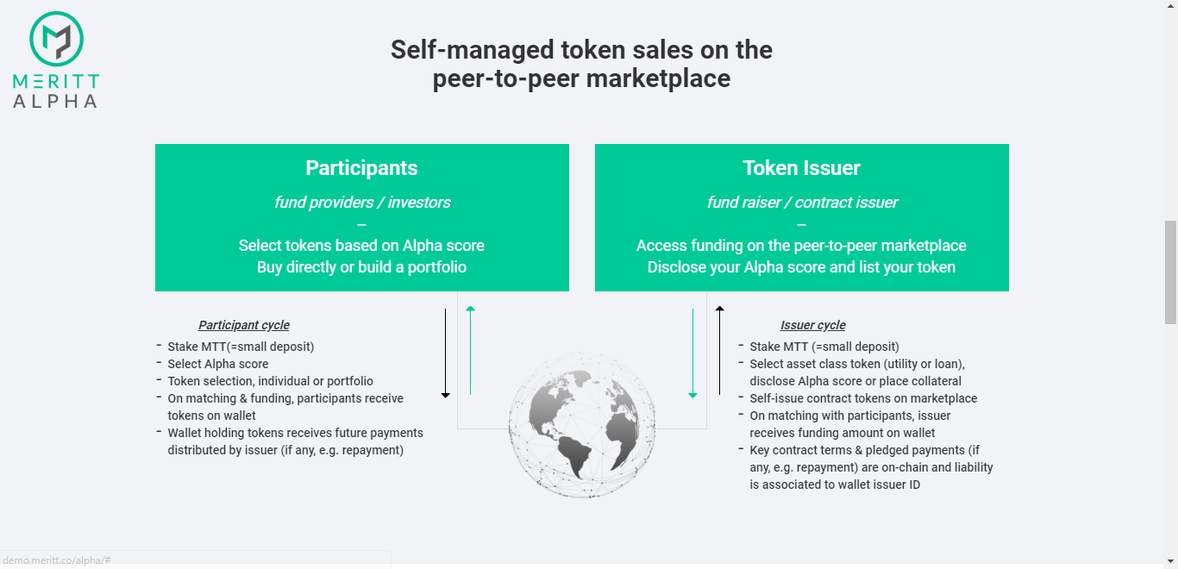
These arrows don t look good, increase weight

Slide 6

My slide
Self-managed token sales on the peer-to-peer marketplace
Participants
fund providers / investors
--
Select tokens based on Alpha score
Buy directly or build a portfolio
Token Issuer
fund raiser / contract issuer
--
Access funding on the peer-to-peer marketplace Disclose your Alpha score and list your token
Participant cycle
Stake MTT(=small deposit)
Select Alpha score
Token selection, individual or portfolio
On matching & funding, participants receive tokens on wallet
Wallet holding tokens receives future payments distributed by issuer (if any, e.g. repayment)
Issuer cycle
Stake MTT (=small deposit)
Select asset class token (utility or loan), disclose Alpha score or place collateral
Self-issue contract tokens on marketplace
On matching with participants, issuer receives funding amount on wallet
Key contract terms & pledged payments (if any, e.g. repayment) are on-chain and liability is associated to wallet issuer ID

Slide 7
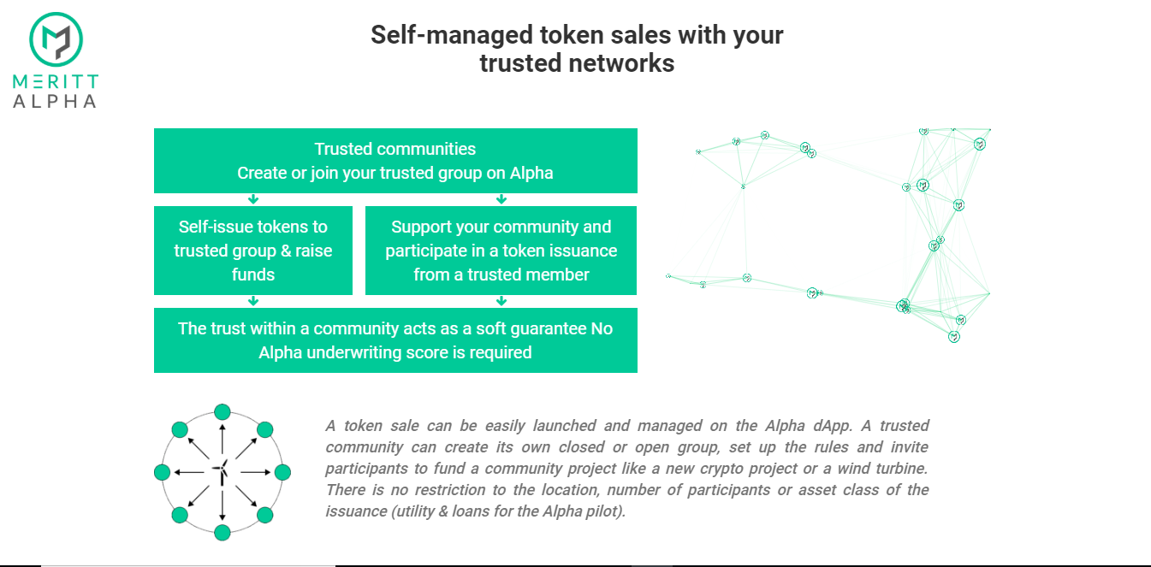
Put the “No” on the second line below

Slide 8
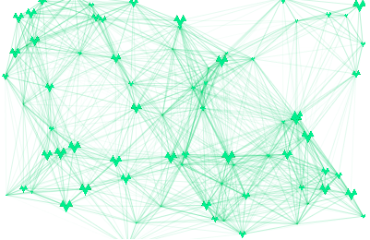
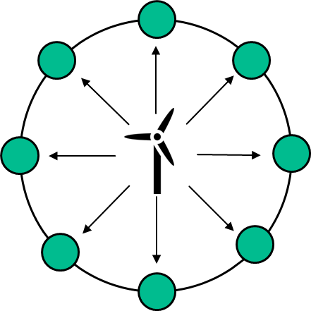
Self-managed token sales with your trusted networks
My slide
Trusted communities
Create or join your trusted group on Alpha
Self-issue tokens to trusted group & raise funds
Support your community and participate in a token issuance from a trusted member
The trust within a community acts as a soft guarantee No Alpha underwriting score is required
Change the green and logo here
A token sale can be easily launched and managed on the Alpha dApp. A trusted community can create its own closed or open group, set up the rules and invite participants to fund a community project like a new crypto project or a wind turbine. There is no restriction to the location, number of participants or asset class of the issuance (utility & loans for the Alpha pilot).
Animation gif see next page

Slide 9

2
1
2
1
$
Animation gif
4
4
3
3
$

Slide 10
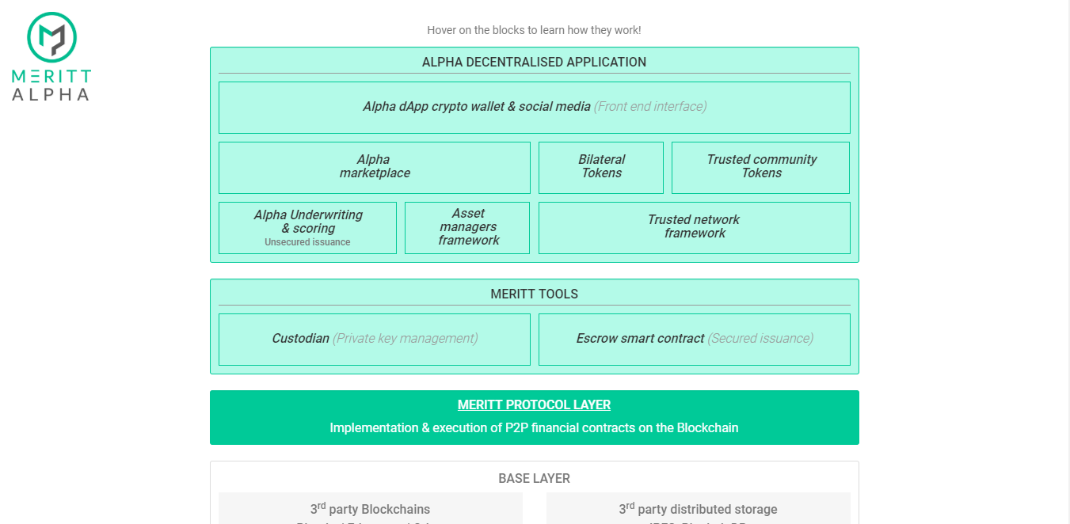
Italic font
Link to protocol page

Slide 11
My slide
Hover on the blocks to learn how they work !
Alpha decentralised application
Alpha dApp crypto wallet & social media (Front end interface)
Alpha
marketplace
Bilateral
Tokens
Trusted community
Tokens
Alpha Underwriting & scoring
Unsecured issuance
Asset managers framework
Trusted network
framework
Meritt tools
Custodian (Private key management)
Escrow smart contract (Secured issuance)
MERITT PROTOCOL LAYER
Link to protocol page
Implementation & execution of P2P financial contracts on the Blockchain
BASE LAYER
3rd party Blockchains
Bitcoin / Ethereum / Other
3rd party distributed storage
IPFS, BigchainDB

Slide 12

New section at the end
Financings, fundings and token sales are not issued by MERITT Alpha. MERITT Alpha is a decentralised application for self-managed token sales & fundraisings on the Blockchain. Peer to peer token sales & fundraisings are implemented on social networks and marketplace. Participants are ultimately responsible for review and approval of the terms and conditions of a particular token sale and of the risks associated. Fundraising requests are only fulfilled if, in a context of social network, a trusted counterparty agrees to it or if, in a context of marketplace, a sufficient pool of liquidity is available. No guarantee is provided by Meritt. Terms of website use.
Replace text

Slide 13
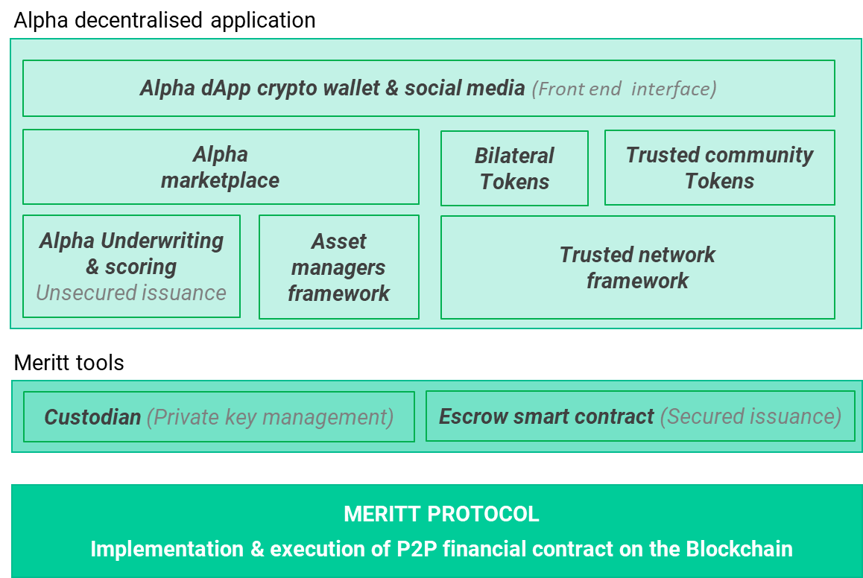
Hovering text
The marketplace ensures investors’ demand in decentralised token issuance. Matching of participants and token issuers for a range of asset class (utility & loan tokens for the Alpha pilot). Participants can fund token issuances based on the issuers’ Alpha score (unsecured ) or the type of collateral (secured)
Decentralised crypto wallet and social media application optimised for mobile use. Interface for participants to create or join trusted networks. dApp also used for token issuance and token purchase on the Alpha marketplace.
Participants & investors select tokens based on Alpha score and buy directly or build a portfolio. Token Issuer access peer-to-peers funding on the marketplace by listing and disclosing their Alpha score.
Bilateral contracts are a closed community between 2 entities like friends or family members. No need for any external intermediaries. Messaging allows direct negotiation of bilateral agreements.
Perform fair & transparent risk assessment & valuation equivalent to an underwriting & scoring on financial contracts and corresponding tokens issued. Alpha underwriting facilitate investment in tokens on the Alpha marketplace and operates in a sovereign data environment, i.e. users retain data ownership & control at all time.
A community can create a private group allowing members to obtain funding from other members. Matching participants with the issuing entity in a closed or opened trusted group. Access is restricted to members and tokens are issued and transacted only under the rule set up for the group.
Secure and highly controlled key storage environment where non-authorised access is impossible. Accessed via the Alpha wallet, or API.
Suite of cross chain escrow smart contracts for crypto asset & currencies as on-chain collateral

Slide 14
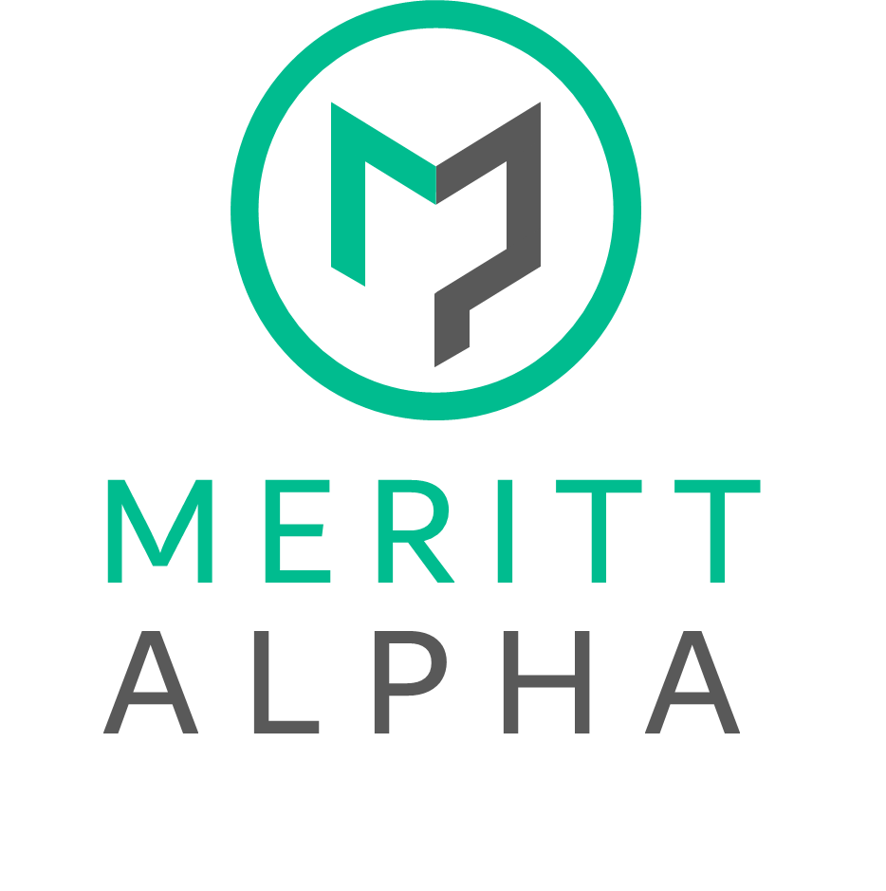
MERITT
ALPHA

